Slide 1
Class intro

Slide 2
Agenda
Bluemix – Watson Day 1
Cognitive apps
Python – DSX Day 2-3
0. Basics
1. In and Export
2. Watson APIs
3. Visualization
4. Spark
5. Machine Learning
6. Training - Deep Learning

Slide 3
Why are you not giving this training?
My basic learning principle:
Let your stupidity serve you

Slide 4
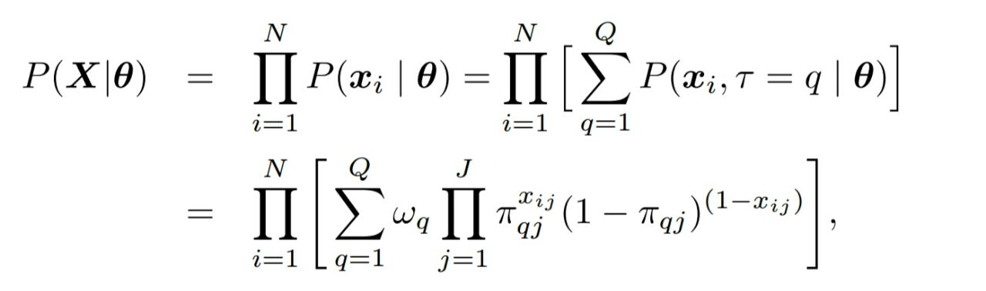

Slide 5
Why is …?
Why is …?
What is …?
What is this?
How is …?
What is the context?
Why is this equal?
What is N?
Why is this equal?
Why is …?
What is …?
How do I compute this?
What is |?
How is …?
How is …?
What does this say?
Why is …?
Why is …?
Why is this equal?
What is J?
Why a sum?
Why a product?
What is …?
Can I fill in data to make an example?
How is …?

Slide 6
Product over number of observations
Context: cluster model
N is number of observations
Equal: choose for one q
Formula expansion
Compute: fill in some data
| means ‘given’
This works like a switch
Expansion of the formula
J is the number of variables
A product let all variable contribute
Example: binomial distribution

Slide 7
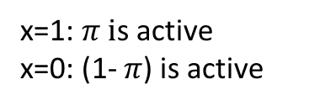
Pers. a b c d e f g h
1 0 0 0 0 0 0 0 0
2 0 0 0 0 0 1 0 0
3 0 1 0 0 0 0 0 0
4 0 0 0 0 0 0 0 1
5 0 0 0 0 0 0 0 0
6 0 0 0 0 1 1 1 1
7 1 0 0 0 1 1 1 0
8 0 0 0 0 1 1 1 1
9 0 0 0 0 1 1 1 1
10 1 1 1 0 1 1 1 1
11 1 1 1 1 0 1 1 1
12 1 1 1 1 1 1 0 1
13 1 1 0 1 1 1 1 1
Cluster
size
Average cluster score
J variables
Q clusters
Probability for variable j in class q
a b c d e f g h
0 .2 0 0 0 .2 0 .2
.25 0 0 0 1 1 1 .75
1 1 .75 .75 .75 1 .75 1
5/13
4/13
Person I scores on variable j
Size (weight) for each clusters
4/13
x=1: $π i$s active
x=0: (1- $π$) is active
N observations

Slide 8
Why are you not giving this training?
My basic learning principle:
Let your stupidity serve you
I’m so dumb that I need to ask (myself) 1000 questions before I have the feeling I understand something.
I’ very dedicated to find the answers to those questions. I know they come in layers and over time
Surprisingly, when other people say they understand something, I often find them settle with having asked themselves way fewer questions.
When I’m asked to explain something, I simply repeat my earlier found answers. That in turn, often results in people finding me smart.
The truth is: they don’t see how much effort it took me to find my own answers. I’m pretty dumb, but I have found a way to make my stupidity work for me.
Your stupidity guides you by exactly showing what you do not understand. Follow that; formulate that into questions. Be persistent in finding answers to those questions. Suddenly other people find you smart.

Slide 9
Why are you not giving this training?
My basic learning principles:
Let your stupidity serve you
Understand whether you understand something or not
Understand what you need to understand and what not - or what you can understand later.
Learn to ask yourself questions – the right questions
Learn to learn - observe how you learn –learn to learn beyond the classroom
Use your moments of clarity wisely
Use multiple sources
Smart Copy Paste – give credit & add value –think creator vs curator
LMGTFY: http://lmgtfy.com/?q=what+is+the+meaning+of+lmgtfy
Make minimal viable examples
Construct a solution as composition of multiple small solved problems.
Explore and produce: with everything you do: produce something reusable
Collaborate & iterate
Understand what your phone and email do to you
Be passionate – find your passion

Slide 10
Take learning in your own hand
All material is set up as self-learning
This training: get yourself up an running to self study
Vote for the topics before start of day 2:
https://codeshare.io/2pAwm4
No input = no vote

Slide 11
0. Basics
1. In and Export
2. Watson APIs
3. Visualization
4. Spark
5. Machine Learning
6. Training - Deep Learning
0. Basics\0. Basics 0. Jupyter notebook
0. Basics\0. Basics 1. Python
0. Basics\0. Basics 2. Numpy
0. Basics\0. Basics 3. Pandas
0. Basics\0. Basics 4. Jupyter notebook magics, shell and R
0. Basics\0. Basics 5. Exercise 0
0. Basics\0. Basics 5. Exercise help
0. Basics\0. Basics 6. Some data.zip
3. Visualization\3. Visualization 0. Matplotlib
3. Visualization\3. Visualization 1. Machine learning techniques
3. Visualization\3. Visualization 2. Pixiedust
3. Visualization\3. Visualization 3. Bokeh
4. Spark\4. Spark 0. rdd-creation
4. Spark\4. Spark 1. rdd-basics
4. Spark\4. Spark 2. rdd-sampling
4. Spark\4. Spark 3. rdd-set
4. Spark\4. Spark 4. rdd-aggregations
4. Spark\4. Spark 5. rdd-key-value
4. Spark\4. Spark 6. mllib-statistics
4. Spark\4. Spark 7. mllib-logit
4. Spark\4. Spark 8. mllib-trees
4. Spark\4. Spark 9. sql-dataframes
1. In and Export\1. import and export 0. Object Storage
1. In and Export\1. import and export 1. Download and upload
1. In and Export\1. import and export 2. DashDB
1. In and Export\1. import and export 3. Cloudant
1. In and Export\1. import and export 4. Twitter
1. In and Export\1. import and export 5. BigInsights
2. Watson APIs\2. Watson 0. Weather API
2. Watson APIs\2. Watson 1. Personality Insights
2. Watson APIs\2. Watson 2. Alchemy News
2. Watson APIs\2. Watson 3. Alchemy language
2. Watson APIs\2. Watson 4. Tone analyzer
2. Watson APIs\2. Watson 5. Natural language classifier

Slide 12
0. Basics
1. In and Export
2. Watson APIs
3. Visualization
4. Spark
5. Machine Learning
6. Training - Deep Learning
5. Machine Learning\5. ML 0. Install requirements
5. Machine Learning\5. ML 1. Introduction
5. Machine Learning\5. ML 2. Data preparation
5. Machine Learning\5. ML 3. Scikit Learn interface
5. Machine Learning\5. ML 4. Bias and variance
5. Machine Learning\5. ML 5. Model evaluation
5. Machine Learning\5. ML 6. Ensemble methods
5. Machine Learning\5. ML 7. Ensemble methods advanced
5. Machine Learning\5. ML 8. Multi Model Ensembles
5. Machine Learning\5. ML 9. Time series
6. Deep Learning\6. DL 0. Keras starter kit
6. Deep Learning\6. DL 1. Fun with activation functions
6. Deep Learning\6. DL 2. Convolutional networks
6. Deep Learning\6. DL 3. Embedding
6. Deep Learning\6. DL 4. Multi-input models
6. Deep Learning\6. DL 5. Auto encoder
6. Deep Learning\6. DL 6. Recurrent networks

Slide 13
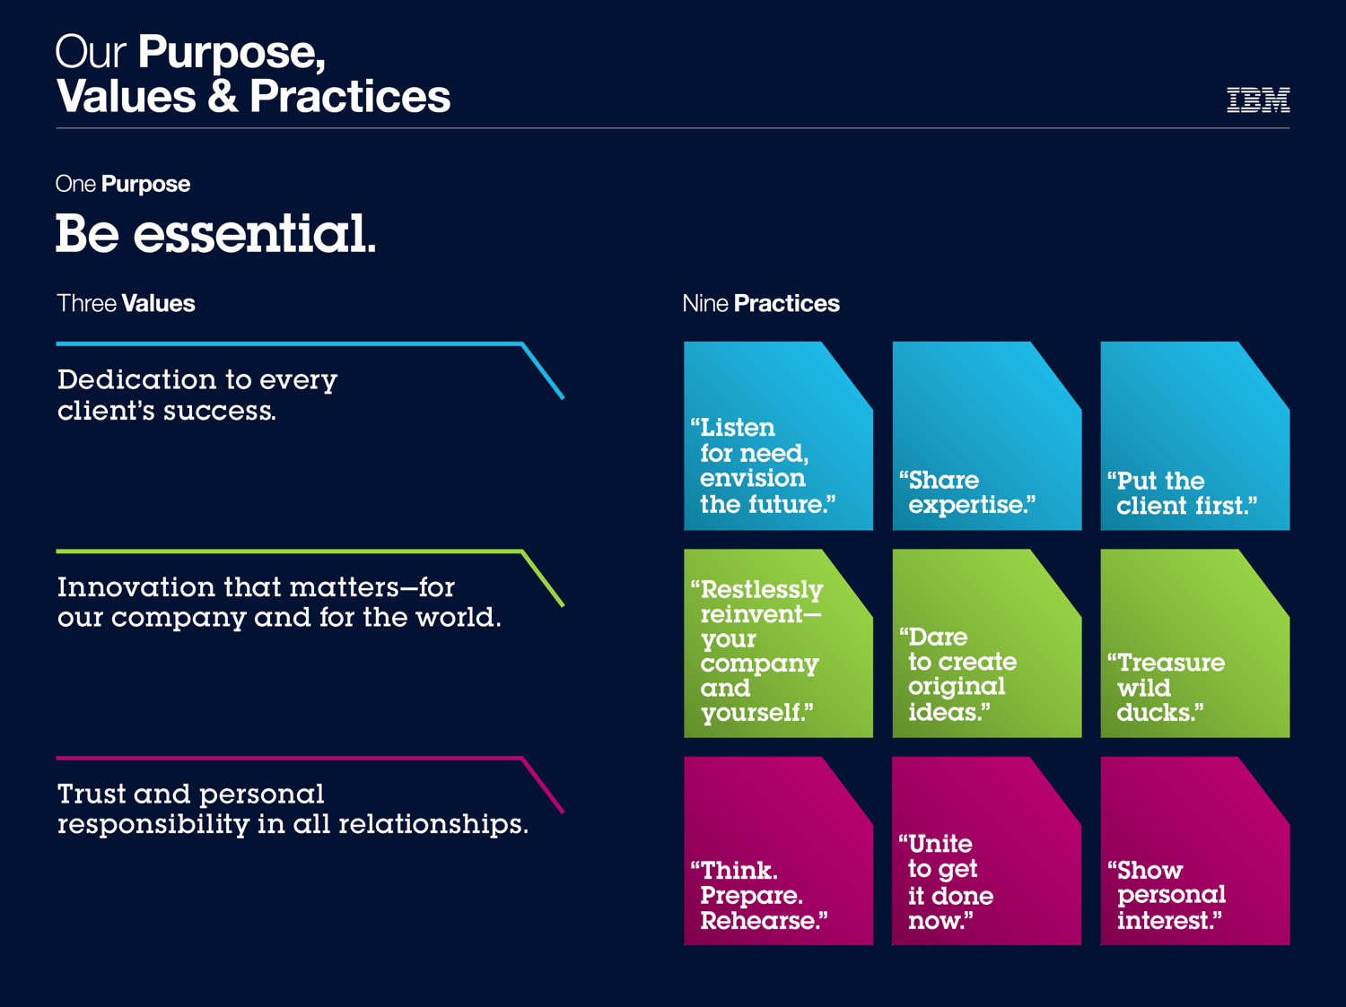
Summary

Slide 14
Preliminaries
IBM Bluemix
https://console.ng.bluemix.net
Data Science Experience
http://datascience.ibm.com/
The standard Bluemix account is restricted to 4 services, with 3 already occupied when you create a Data Science Experience instance. We need more for the training. Please open a ticket with Bluemix support and put this in the body: -----------------
I am an attendee of the Data Science Experience training in Singapore held from 3-5 April. I am responsible for demonstrating the capabilities of the DSX and the Bluemix services and the integration of those to our clients and prospective clients. The free Bluemix account is too small and limited to support my needs during the training. Therefore, I need your assistance and am requesting the special IBM Bluemix account to allow me to create up to 20 services, gives me up to 4GB of application memory. My Bluemix ID is, myemail@domain.com. If you need any further authorization or clarification about this request please contact the training of the session Dr. Olav Laudy (olavlaudy@ph.ibm.com)

Slide 15
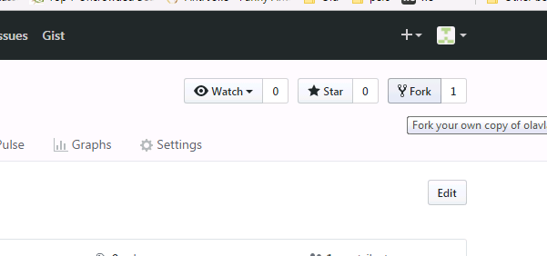
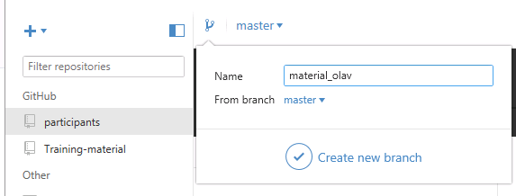
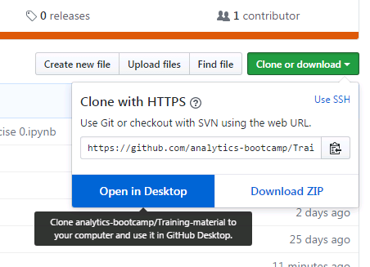
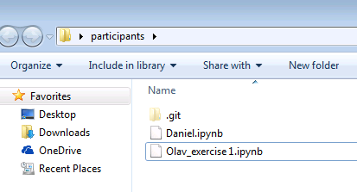
Sign up on https://github.com/ & install GitHub Desktop: https://desktop.github.com/
Log in and fork the following repositories in your own space:
https://github.com/analytics-bootcamp/Training-material
https://github.com/analytics-bootcamp/participants
Step 1: browse to the links above and click fork
Step 3: create a branch with your own name
Step 2: clone your repository locally
Step 4: add material to the local folder: use your name in the filename

Slide 16
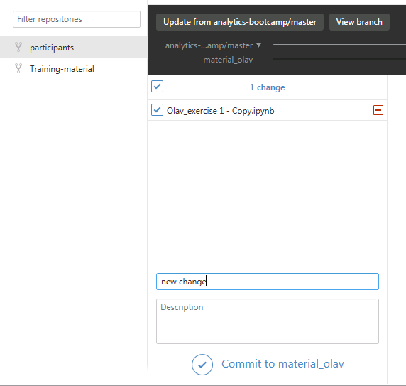
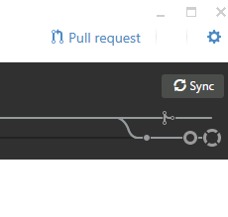
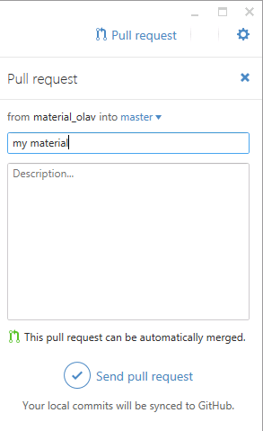
Step 5: commit material to your repository
Step 5: sync
Step 6: request for it to be added to bootcamp repository

Slide 17
Day 1: Switch-board your own cognitive application
Switch-board your own cognitive application
Design something that can be done in an afternoon
Solve world hunger vs Scan Trump statements for sentiment.
Having a simple working app >> having a complex non-working app
Use 3-5 components:
Data source – news API – URL – Twitter
Transporter – Node RED - DSX
Cognitive component – News API – Alchemy (text/image) - Conversation
Output – Slack – Line messenger – DSX –Twitter – http POST
Storage – Cloudant – DashDB
Deliverables
A PowerPoint with:
Objective of the app – what does it do
Description of components
Screenshotted demo
Working demo
Work in teams of 2 or 3. A 4th person on the team can get away with doing nothing.
“I’m not that skilled yet; I’ll watch over your shoulders”

Slide 18
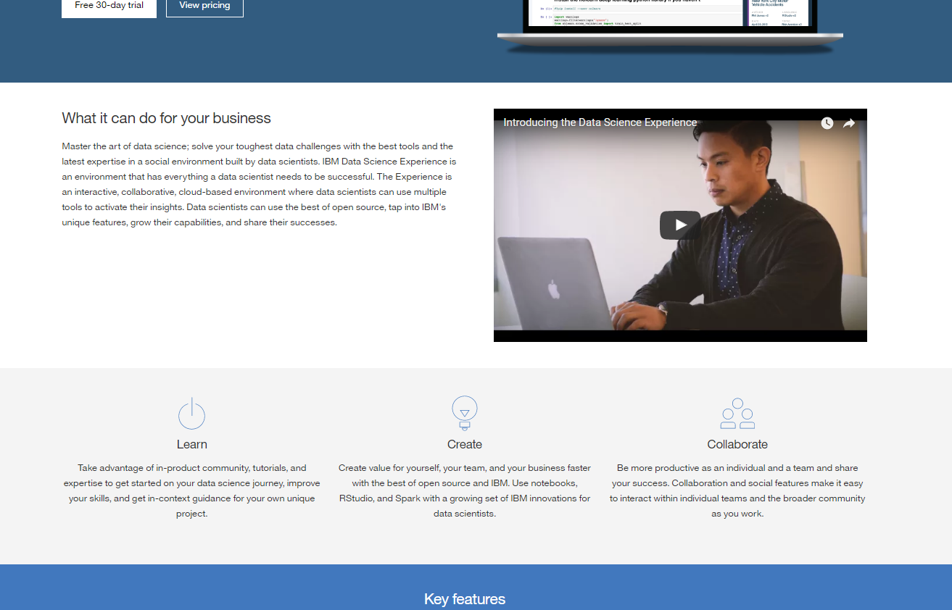
Cosmetics are convincing
Not properly cut out
Not curated
Doesn’t play
Unreadable

Slide 19



Cosmetics are convincing

Slide 20
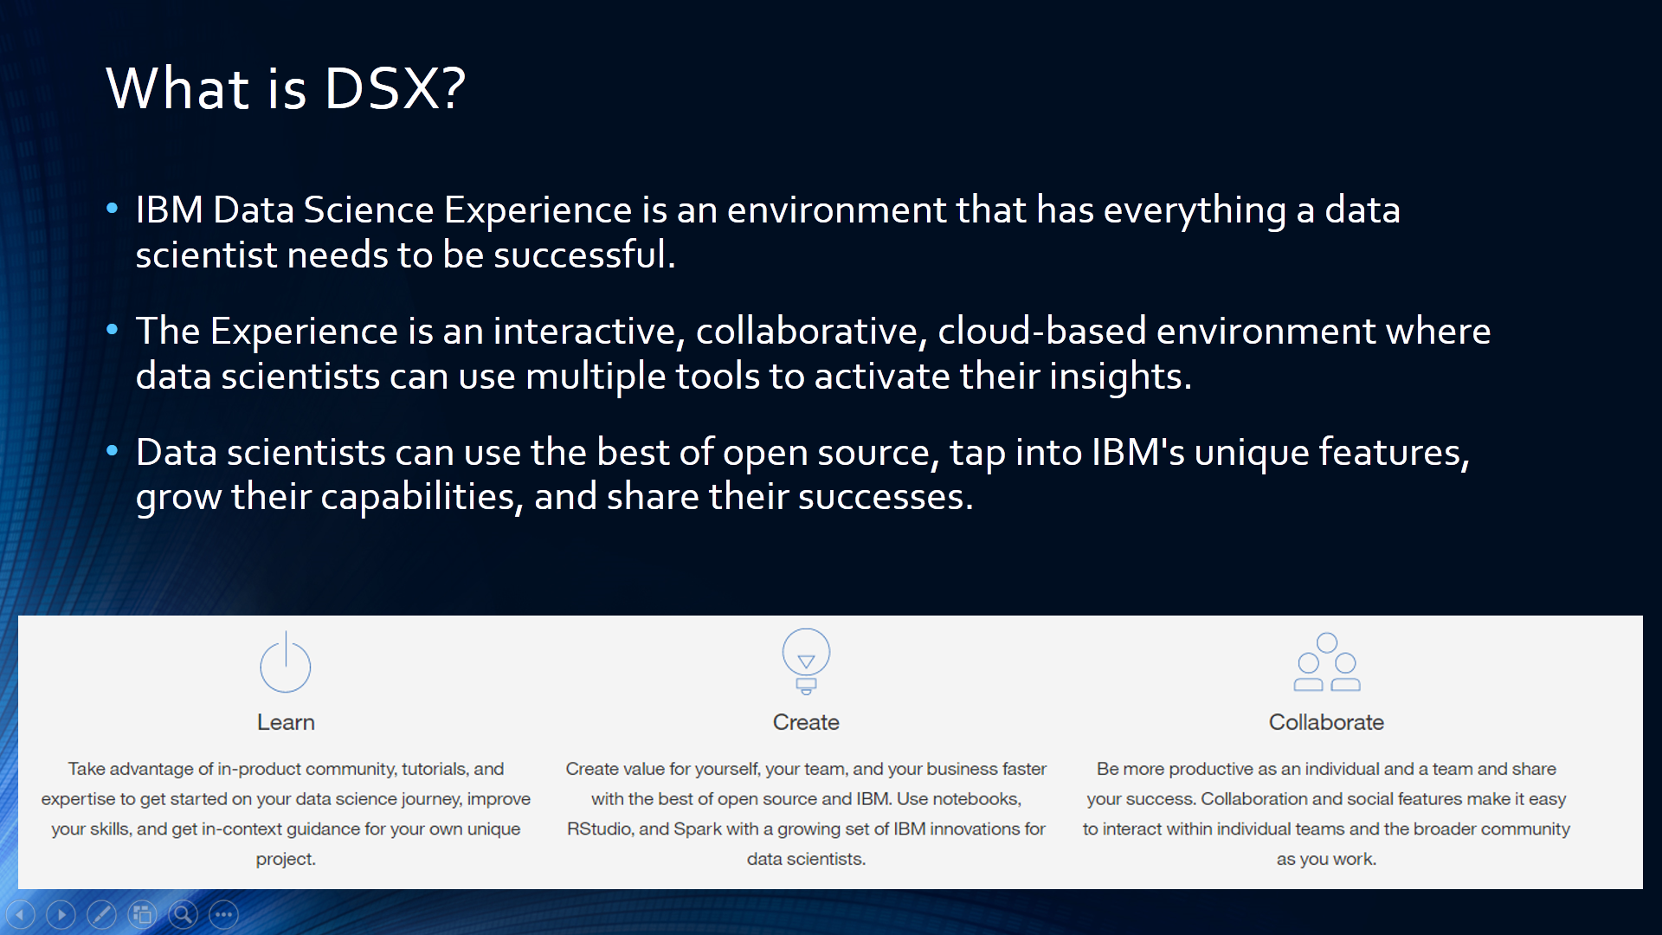

Slide 21
WATSON-BLUEMIX SESSION

Slide 22
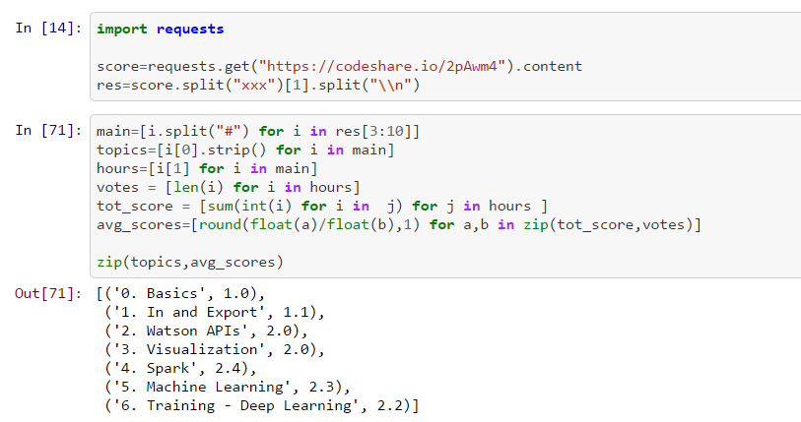
Understanding basic Python: exercise
Exercise: understand the agenda voting code
https://github.com/analytics-bootcamp/Training-material/blob/master/agenda%20voting.ipynb

Slide 23
Understanding basic Numpy: exercise
import numpy as np
a=np.arange(0,10,2)
b = np.repeat([['yes', 'no']], 5,axis=0).reshape(10)
What is the result of
b[a]

Slide 24
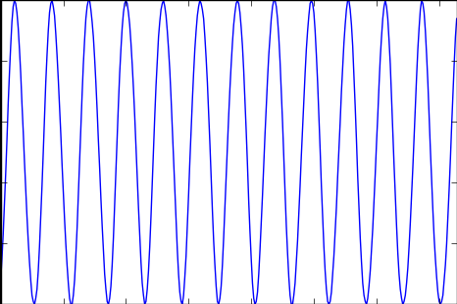
Day 2 exercise: Moon phases
This site contains the moon phases:
http://aa.usno.navy.mil/data/docs/MoonFraction.php
Download this data and convert in the appropriate format (think about what appropriate means)
http://aa.usno.navy.mil/cgi-bin/aa_moonill2.pl?form=1&year=2017&task=00&tz=-05
The result:
https://github.com/analytics-bootcamp/Training-material/tree/master/0.%20Basics
0. Basics 5. Exercise 0.ipynb is the base notebook
0. Basics 5. Exercise help.ipynb is the fill-in exercise when 0 is too difficult.

Slide 25
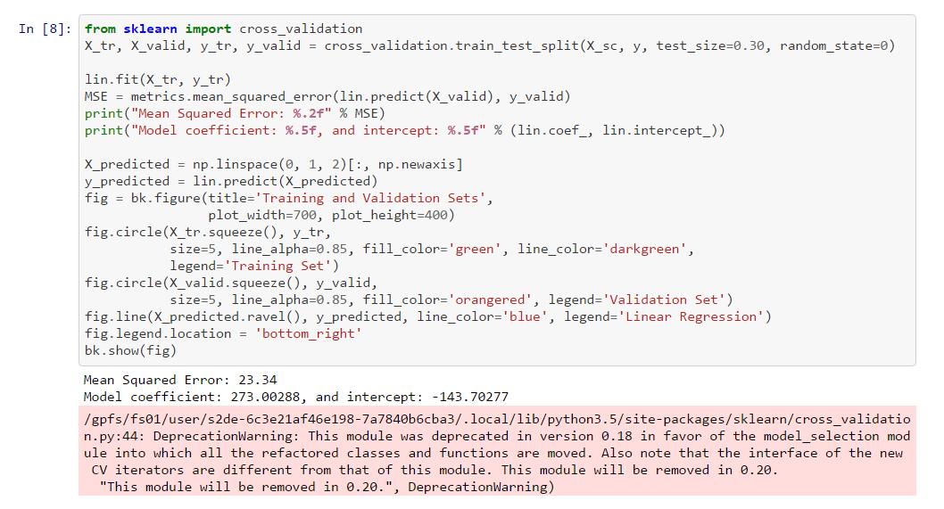
Day 2 exercise: solve the warnings in Sci-kit learn

Slide 26
Day 3 exercise: Build a deep learning model that sorts a set of numbers

